Slide 1
Fundamentals of SDM
Design thinking workshop
Wednesday 15:15-16:45, Spring, 2012
Takashi Maeno
Toshiyuki Yasui
Seiko Shirasaka
Graduate School of System Design and Management
Keio University, JAPAN

Slide 2
Schedule
4/11 Whole view of innovative system design (Maeno)
4/25 Team building (Shirasaka)
5/2 Brain Storming (Maeno) APCOSE (Yasui & Shirasaka absent)
5/9 System thinking (Yasui)
5/16 Observation (Maeno)
5/23 Value Graph (Yasui)
5/30 Scenario Graph (Shirasaka)
6/6 Special lecture of English paper writing (Melinda Hull) (16:45-18:45)
6/13 CVCA/WCA (Maeno)
6/27 Pugh concept selection (Yasui)
7/4 Prototyping for empathy and test (Shirasaka)
7/18 Final Presentation

Slide 3
Today’s outline
Who am I?
Who are we? (Self introduction and practice of presenting)
  GCOE Ras, SDM students (Master and Ph.D course)
What is SDM?
What is SYSTEM THINKING?
What is DESIZGN THINKING?
Discussion on topics

Slide 4
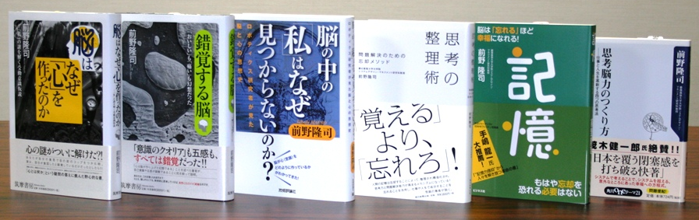
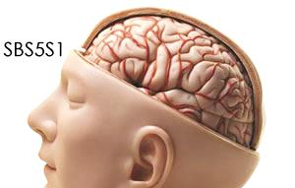
Takashi Maeno
前野 隆司
Mind and body of humans
Mind and body of robots
Philosophy and ethics
Mechanical Engineering
Happiness study
Social system design

Slide 5
Practice of self introduction
Make pairs
Introduce each other for one minute each.
One minute free conversation
One minute to take a note. Write down what were strong points of your partner’s self introduction.

Slide 6
60 seconds
０
０
０
１
２
３
４
５
６
７
８
９
１０
１１
１２
１３
１４
１５
１６
１７
１８
１９
２０
２１
２２
２３
２４
２５
２６
２７
２８
２９
３０
３１
３２
３３
３４
３５
３６
３７
３８
３９
４０
４１
４２
４３
４４
４５
４６
４７
４８
４９
５０
５１
５２
５３
５４
５５
５６
５７
５８
５９
６０

Slide 7

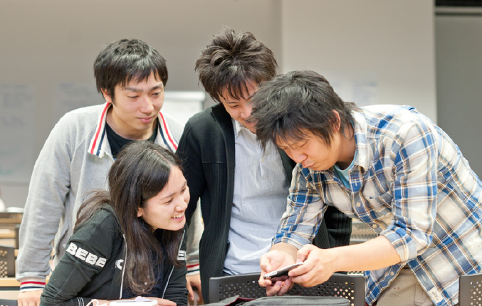
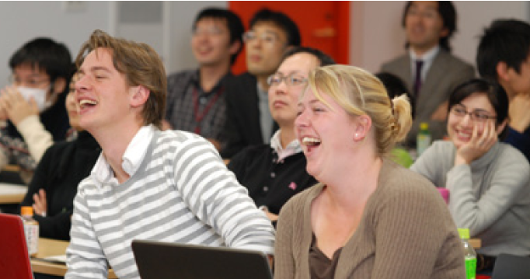
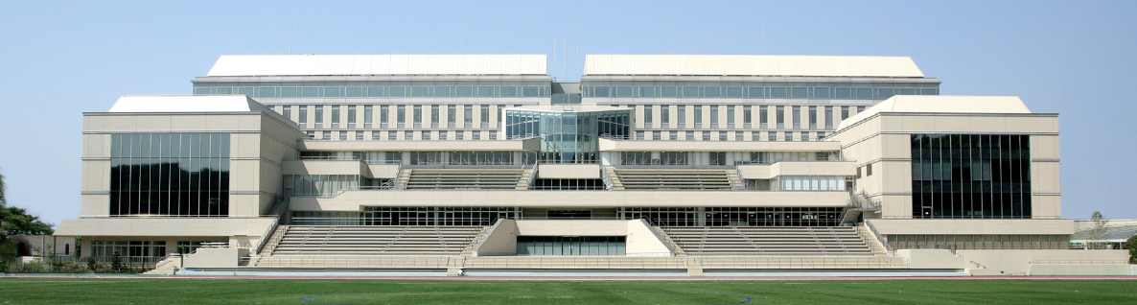
What is System Design and Management?
How can we realize systemic and systematic design?
Takashi Maeno, Dean, Professor
Graduate School of SDM, Keio University

Slide 8

Designing the Future
Celebrating 150 years with the slogan of ‘Design the future’ in 2008
We believe that collaboration with industries, government organizations and other universities, domestic or overseas, will be beneficial for all parties to produce fruitful results.
Systems Engineering will play a key role to design the future.

Slide 9


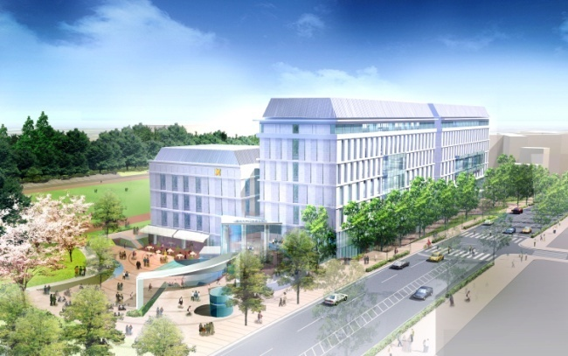
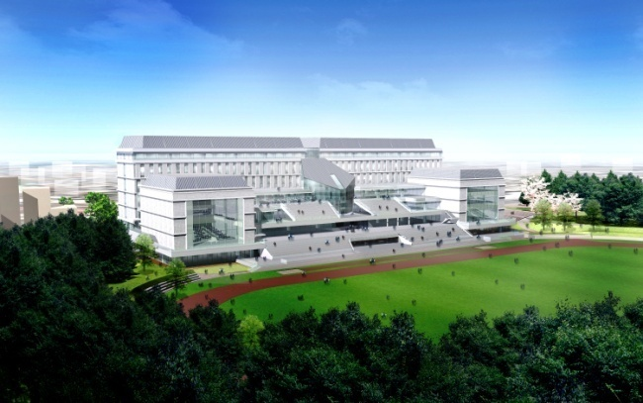
Graduate School of
System Design and Management
■ A new program to foster social/
technology leaders of the 21st
Century
9

Slide 10
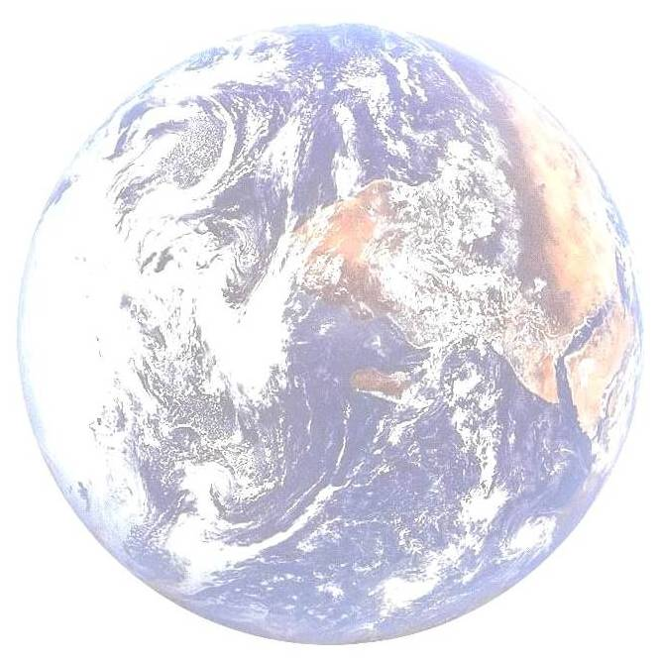
バランス
全体最適
グローバル
相互理解
balance
holistic solution
global
mutual understanding
可視化
現代社会が直面する問題を解決
多視点
visualization
Solve problems that modern world is facing
multiple viewpoint
システマティック
システミック
systematic
systemic
リーダーシップ力
国際性
連携マネジメント
ビジネス化
デザイン力
マネジメント力
自我作古
国・地方
産業界
SDM
SDM
創造力
システム力
実行力
人材育成
大学・研究所
社会貢献
コミュニケーション能力
国際的学術成果
SDM研究科の人材育成
SDM研究所の国内外連携
教育
雇用
国家ビジョン
貿易
格差
education
employment
national policy
trade
disparity
技術のガラパゴス化
現代の問題
年金
TPP
領土問題
technical Galapagosize
pension
territorial issue
理系離れ
資源
modern problem
防衛
外交
resource
セキュリティー
defense
the trend away from science
農業
diplomacy
agriculture
security
国際競争力の低迷
エネルギー
国家財政破綻
energy
the national financial collapse
the decrease in global competitiveness
自然災害
環境問題
natural disasters
environmental problems

Slide 11
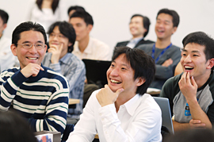
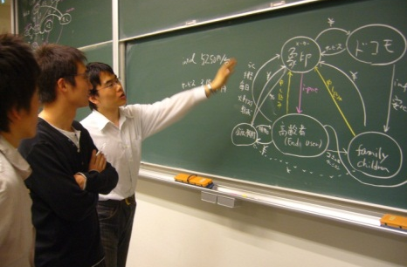


SDMのコンセプト
Concept of SDM
Design education by design project based on design thinking workshops)
Management education based on project management and business classes
Classes related to PMP (Project Management Professional)
Concept design and verification/ validation
leadership
inernational
System education based on systems engineering
design
management
Create the classic
creiative
system
Core-classes on systems engineering
active
communication

Slide 12

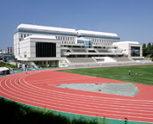


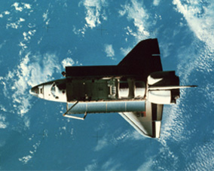
SDMは、問題を解決します。
SDM solves problems.
holistic solution
バランス
環境共生
全体最適
社会協生
balance
相互理解
environmental
symbiosis
social
collaboration
mutual understanding
安心・安全
問題解決
security and safety
国際問題
problem-solving
international problem
科学技術
健康・福祉
政治経済
science and technology
health and welfare
politics and
economics
人間理解
グローバル
understanding of people
global
リーダーシップ力
国際性
連携マネジメント
ビジネス化
デザイン力
マネジメント力
自我作古
国・地方
産業界
創造力
システム力
実行力
人材育成
大学・研究所
社会貢献
コミュニケーション能力
国際的学術成果
SDM研究科の人材育成
SDM研究所の国内外連携
Human resource development
Domestic and international collaboration

Slide 13
What is a system?
Group of parts, which shows relevance each other
and can function after assembling
Dividing a cow in half does not give you
smaller cows.
0944-98
Notes:
13

Slide 14
Importance of systemic/holistic view
0943-98
Innovation Associates
Notes:
14

Slide 15
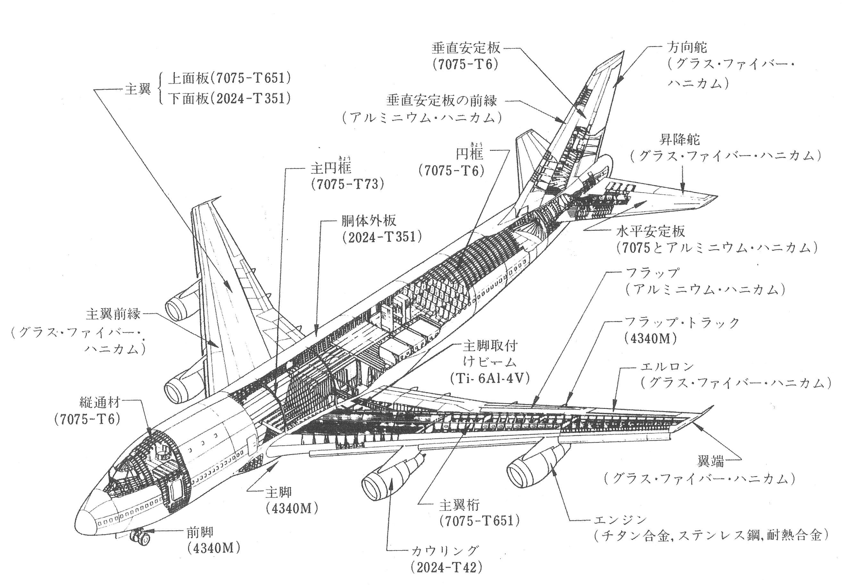
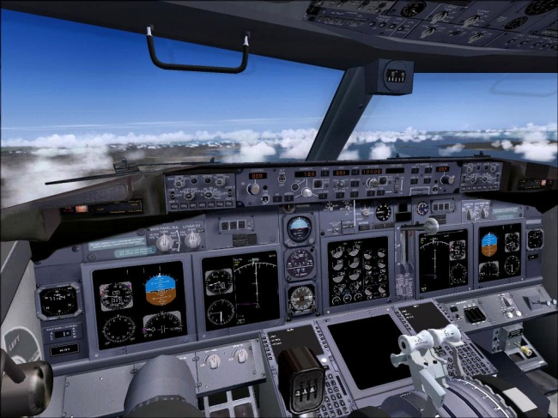

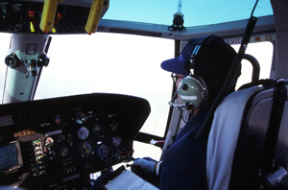
Navigation System
Cabin Service System
Cockpit System
Cabin System
Attitude Control System
Communication System
Crew System
Engine System
Radar System
System of Systems
Landing Gear System

Slide 16
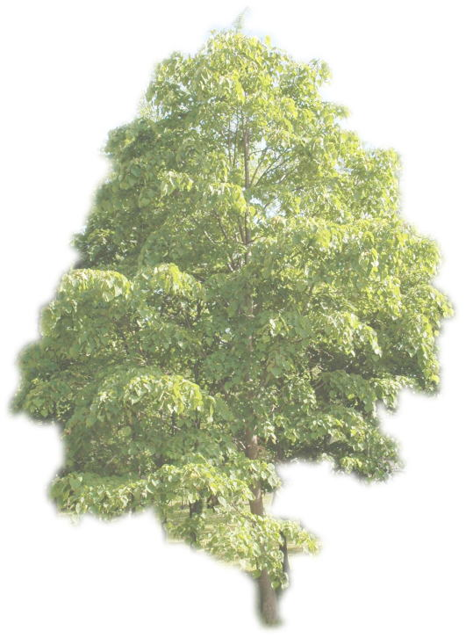
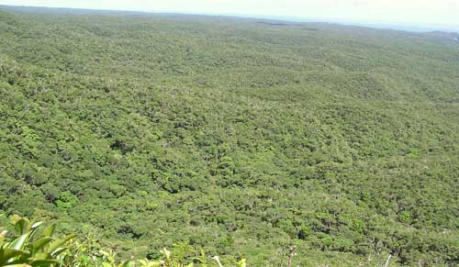
What is important in system design?
Japanese proverb: 木を見て森を見ず
Some people can't see the forest for the trees.
(They can't draw the big picture.)
System Design: 木を見て森も見る
See both the forest and the trees, simultaneously.
(Design both complex system and its detail.)

Slide 17
SDM, Keio
-12 full time professors
-More than 20 visiting/part-time professors
-77 master course students per year
-11 doctor course students per year
-3rd and 6th floor of 協生館 (Collaboration complex) in front of Hiyoshi station

Slide 18

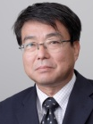
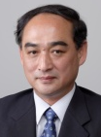
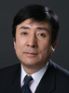

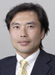
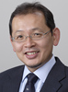
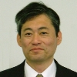

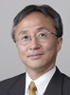
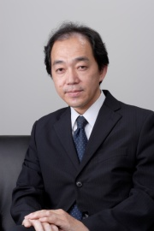
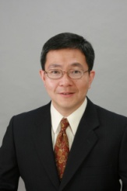
SDM Full-time Faculty members
Hijini, L., Ken
Comparative political nstitutions,
party organization theory,
Sasaki, Shoichi
Design of environmental harmony type movable systems
Takano, Kenichi
Risk management and human factor on Technological system
Teshima, Ryuichi
Intelligence and crisis management of huge and complex systems
Shirasaka, Seiko
Space systems engineering, system development methodology,
Nishimura, Hidekazu
Safety control systems design for automotives, railways and structural systems
Maeno, Takashi
Creative design of robot and man-machine systems
Nakano, Masaru
Design of systems and processes on integrated global business
Kohtake, Naohiko
Design and management for space systems and ubiquitous systems
Haruyama, Shinichiro
Total design of hardware, software and communication system on ubiquitous society
Ogi, Tetsuro
Virtual reality, tele-immersion and visual simulation
Toma, Tetsuya
System research and development for advanced display devices
Most of the faculty members have experience in industries or R&D organizations such as TOYOTA, Canon, 3M, MRI, MELCO, JAXA, Bell Labs.

Slide 19
Covered Fields of Research & Education

Slide 20
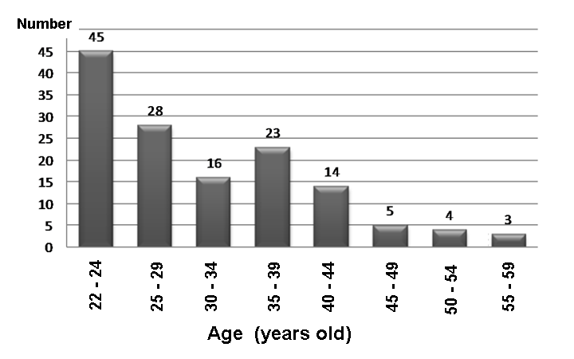
Age Distribution of students in SDM (2011)
Master course students
Increasing demand of recurrent education after job experience
Ph.D. course students

Slide 21
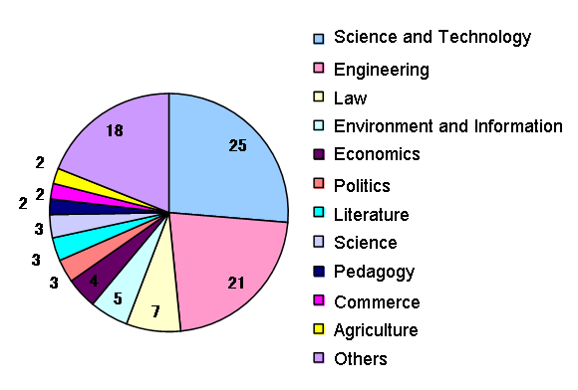
Variety of students background

Slide 22
Curriculum Chart and
Degree Scheme
First Year
Second Year
Core Courses
Core Courses
Recommended Courses / Electives
Recommended Courses / Electives
Design Project
Design Project (ALPS)
Research of System Design and Management
Research of System Design and Management
Distance learning and e-learning
Distance e
-
learning (To be started after 2009)
Master and Doctor Degrees:
- Master of Systems Engineering or System Design and Management
- Ph.D. in System Design and Management
- Degrees available only taking English courses
Admission:
- Entrance : Twice a year, April and September
- Quota: 77 master students and 11 doctoral students each year
- Distance interview using Skype is available
Requirement for Master Program:
- Minimum of 30 credits
- Minimum 14 classes of 90 minutes each required for 1 credit
- Design Project (ALPS), core courses and Master thesis

Slide 23




Design Project
“ALPS (Active Learning Project Sequence)”
  “ The ALPS is what SDM is expected to provide for. Any other university of Japan does not have an ALPS-like course. It is extensive, exciting and fruitful. It’s a revolution of Japanese education system.” – Voice of students
Design thinking
System thinking
International
Collaboration
Stanford University
Notes:
23

Slide 24
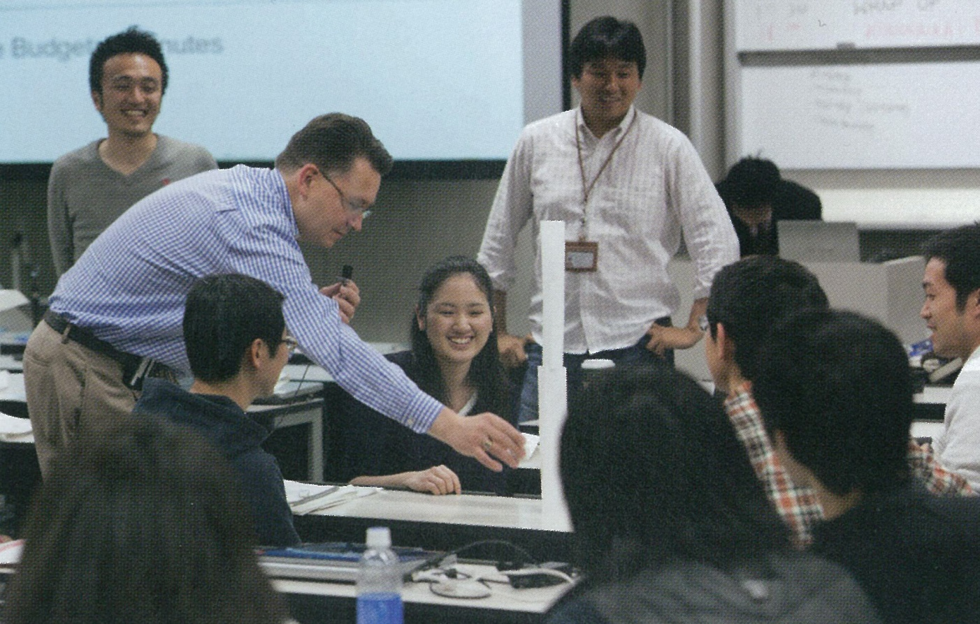
Presentation of “Prototyping rapidly” at “ALPS”.
Presentation of “Prototyping rapidly” at “ALPS”.
Presentation of “Prototyping rapidly” at “ALPS”
Sponsored by companies,
such as Toshiba, JGC, NEC
Presentation at prototyping rapidly

Slide 25
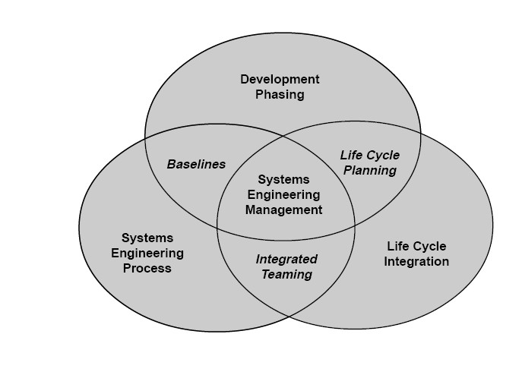
What are systems engineering, systems thinking
& design thinking?
Systems engineering is an interdisciplinary field of engineering focusing on how complex engineering projects should be designed and managed over their life cycles.

Slide 26
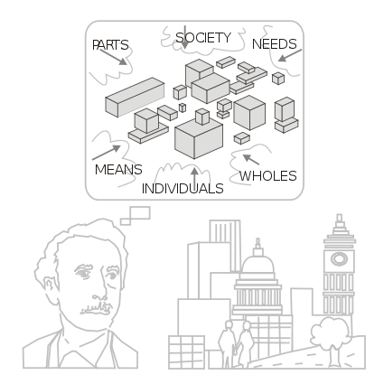
Systems thinking (wide sense)
Systems thinking is the process of understanding how things influence one another within a whole.
In nature, systems thinking examples include ecosystems in which various elements such as air, water, movement, plants, and animals work together to survive or perish.
In organizations, systems consist of people, structures, and processes that work together to make an organization healthy or unhealthy.

Slide 27
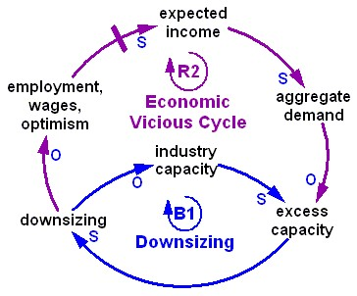
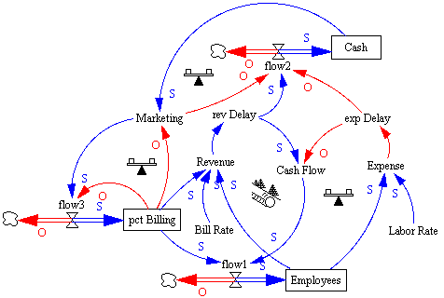
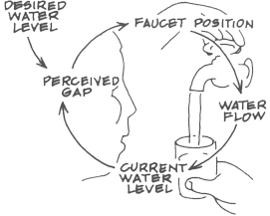
Systems thinking (narrow sense)
Drawing and Analyzing process of causal loop diagrams are sometimes called systems thinking.

Slide 28
Design thinking
Design Thinking refers to the methods and processes for investigating ill-defined problems, acquiring information, analyzing knowledge, and positing solutions in the design and planning fields.
Focus on:
  Ethnographic observation
  Brain storming
  Prototyping for empathy

Slide 29
How System/Design thinking merge?
Systems engineering:
Design thinking:
V-model:
-Decomposition and integration
-Design and V&V
Ethnographic observation and understanding
Requirement analysis
Prototyping for empathy
Verification & Validation
System architecting
Innovation based on brain storming
Prototyping for test
System design
V&V
Component design
V&V
What they aim are close each other!

Slide 30
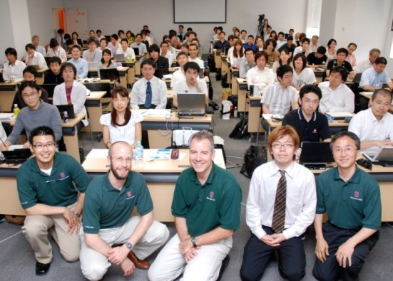
Methods to be Learned
1
Start Up / Overview
5
Validation
Systems Engineering and Design Thinking,
V-model, Team Building, Repeat for Innovation, Philosophy of Design
Prototyping for Test,
AHP, Interview (to Professionals),
Questionnaire, Social Experiment
Idea Creation
2
Brainstorming, KJ-method, Mind Map etc.
Understanding and
Architecting
3
Fieldwork, Ethnography, Participatory Observation,
CVCA, WCA, Value Graph, Scenario Graph, Use Case, etc
System Design and
Evaluation
4
Enabler Flame Work, QFD, FFBD, OPM, Morphological Analysis,
Pugh Concept Selection, Prototyping for Empathy, etc.

Slide 31
Discussion on topics and team building
What kind of innovative solution do you want to get?
How to brainstorm? (by IDEO, California)
  stay focused on the topic
  encourage wild ideas
  defer judgment to avoid interrupting the flow of ideas
  build on the ideas of others
  hold only one conversation at a time to ensure that introverts also got their say
  go for quantity (150 ideas in 30 to 45 minutes)
  be visual
Notes:
まず、各人に質問、それをもとにみなでグルーピング。その後ブレスト？

Slide 32
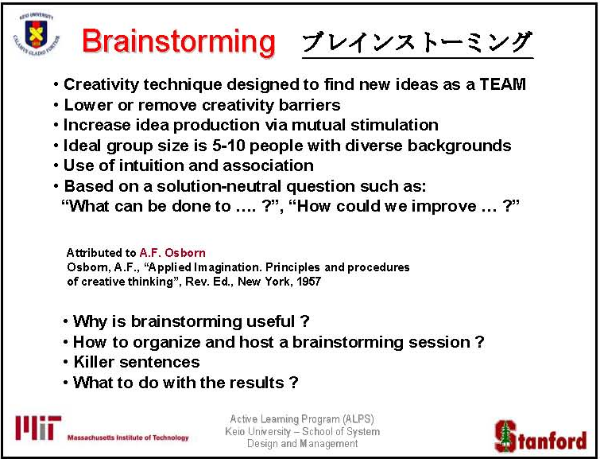
５～１０名

Slide 33
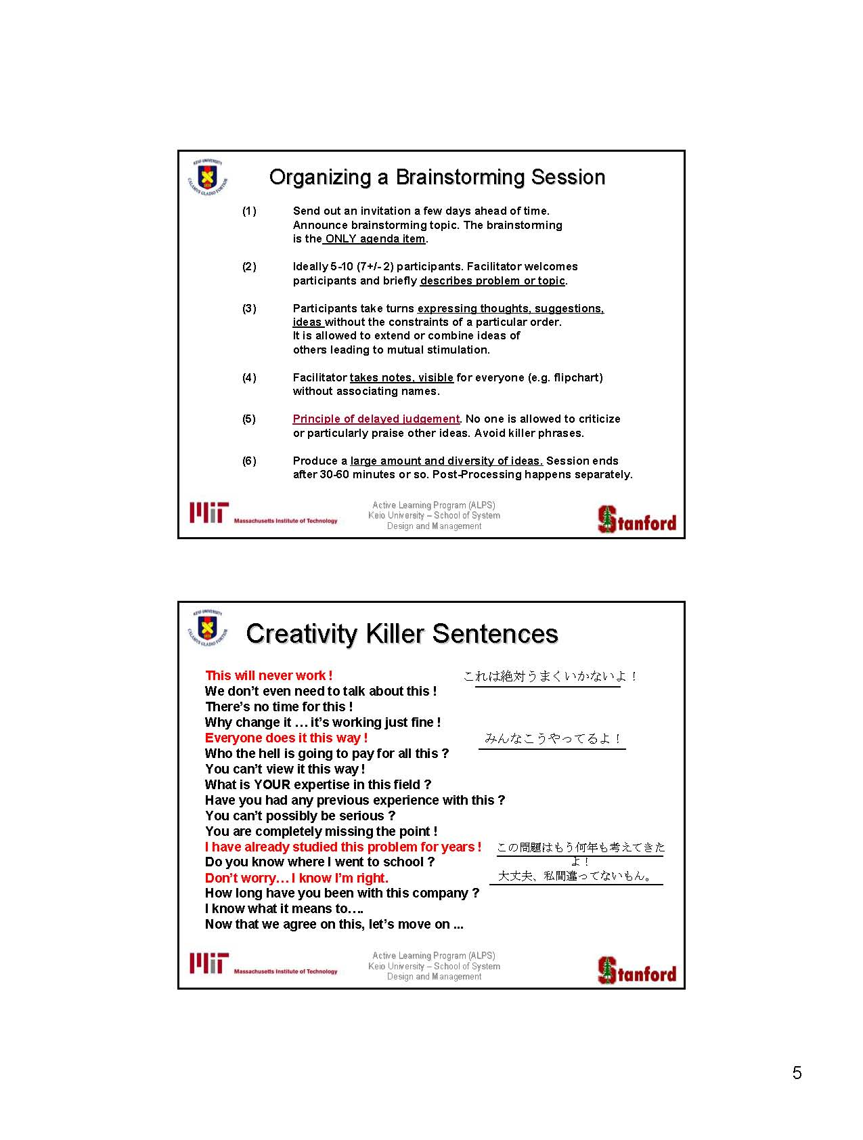
創造性を殺す
ダメな言い方
どうして変えるんだよ。うまくいってるからいいじゃん。
そんなの誰が買うかな！？
そういう見方は違うんじゃない？
評論じゃなく、君の経験を聞きたいんだ
だいたいやったことあんの？
まじめにやれないの？
全然的を得ていないよ
俺がどこの大学を出たか知っているのか？
それはもう知ってるよ
それはもうわかったから次へ行こう

Slide 35
Whole View that I want you to understand（by Maeno）
Multi and Meta Thinking
How-Why diagram
Enabler framework
Various viewpoints, scale in time and space, overview of multiple constraint
Brain storming
Prototype for empathy
Pugh concept selection
Divergence Thinking
Causal Loop
CVCA/WCA
Scenario graph
Collective
Intelligence
visualization
Human centered
Objective world
Subjective World
Systematic Approach Systemic Approach
Self
users
Diverse stakeholders
organization
others
products
service
Participatory observation
Reductionist’s
Approach
Ethnography
Fieldwork
Logical thinking
MECE
Prototype for test

Slide 36
伝えたいことの全体像（前野によるまとめ）
マルチ・
メタ思考
How-Why diagram
Enabler framework
視点の位置・時間スケール・空間スケールの移動、様々な拘束条件の超越
Brain storming
Prototype for empathy
Pugh concept selection
発散思考
Causal Loop
CVCA/WCA
Scenario graph
集合知思考
可視化思考
人間中心思考
主観世界
客観世界
多様なステークホルダ
Systematic Approach Systemic Approach
自己
ユーザ
組織
コト（サービス等）
他人
モノ（製品等）
参加型
思考
分解思考（従来型
要素還元思考）
Ethnography
Fieldwork
Logical thinking
MECE
Prototype for test

